Slide 1
SECURITY SYSTEM
Student: Cristea Tudor
Group: 30433
Coordinating Professor: Prof. Dr. Dănescu Radu

Slide 2
PURPOSE
The “Security System” has the purpose of keeping a hypothetical door of a house locked until a person (supposedly, the owner of the house) comes near the system, enters a correct code on the keypad and validates the correct key fob on the reader. If the entered code is incorrect, then the person is informed of this mistake and is invited to try again. However, if three incorrect codes are entered, the alarm will be activated, and it can be stopped only if a special reset code is entered on the keypad.

Slide 3
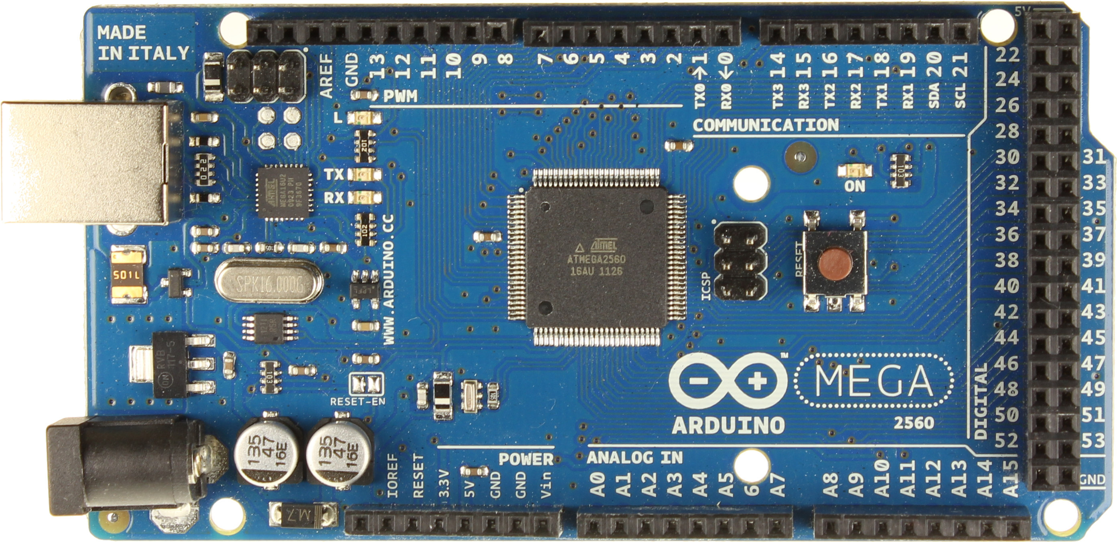
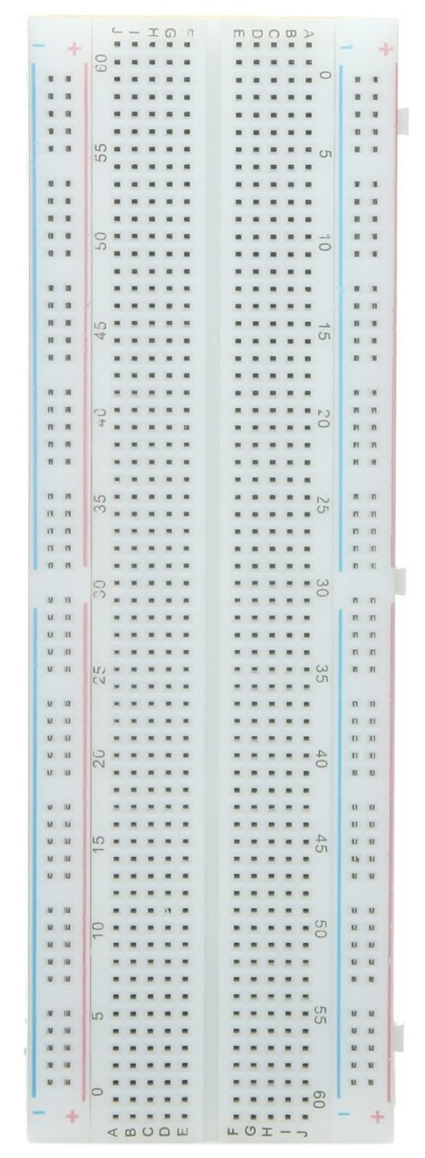
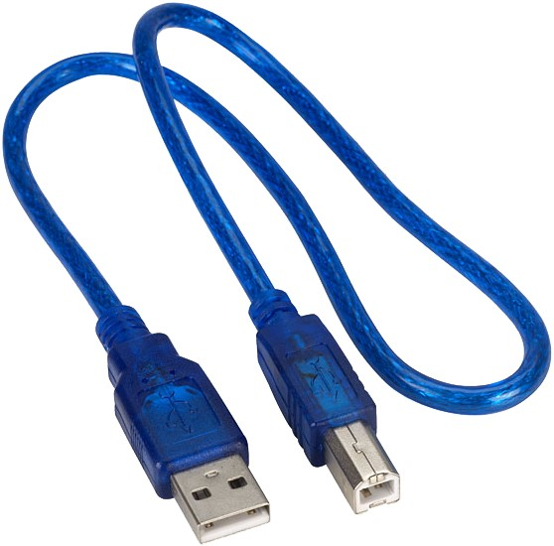
COMPONENTS
Arduino Mega 2560
Large Breadboard
USB A-B Cable

Slide 4
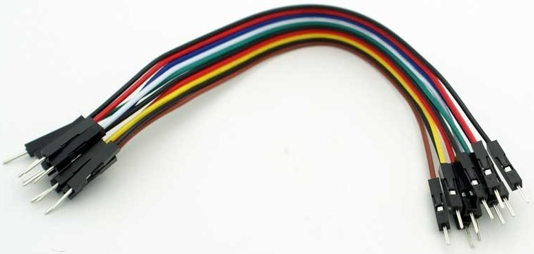
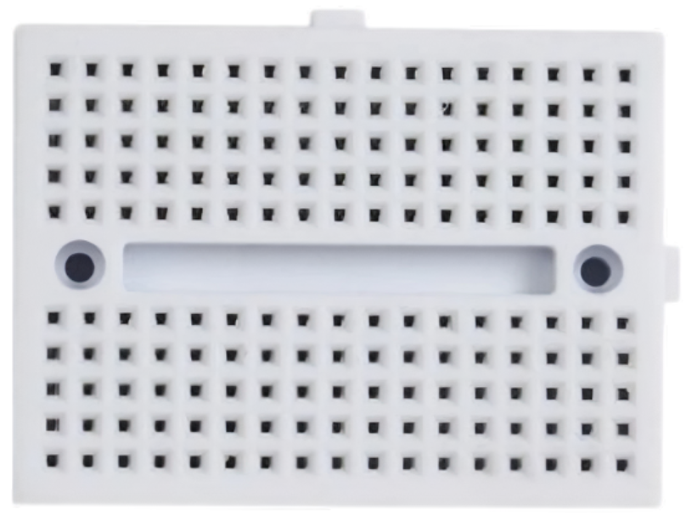
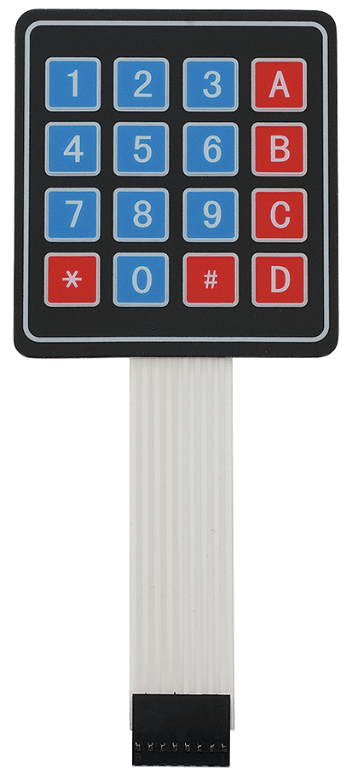
COMPONENTS
4x4 Matrix Membrane Keypad
Jumper Wires
Mini Breadboard

Slide 5
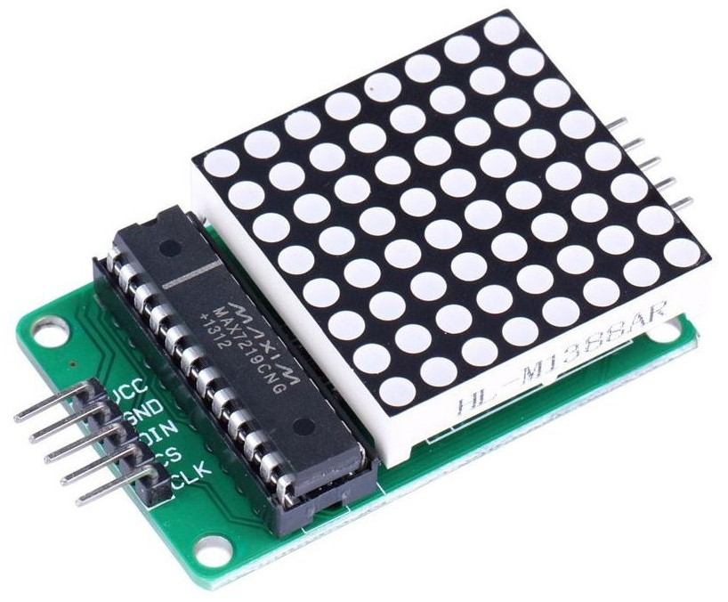
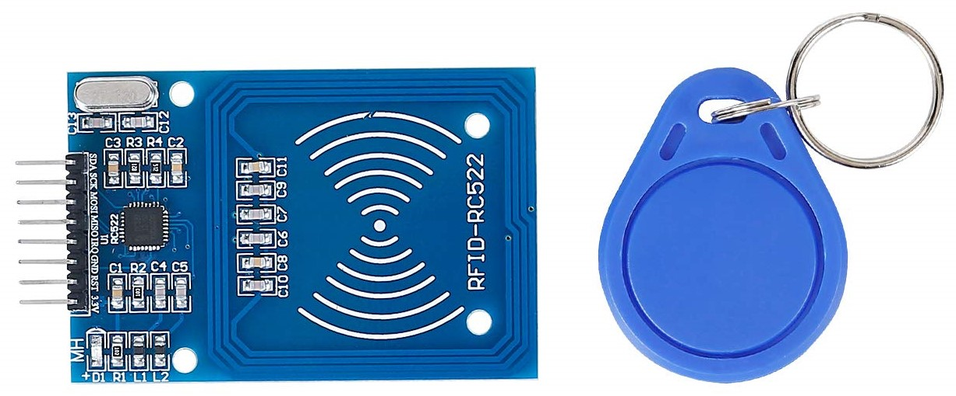

COMPONENTS
8x8 DOT Matrix (MAX7219)
RFID Card Reader (RC522)
Servo Motor (SG90)

Slide 6
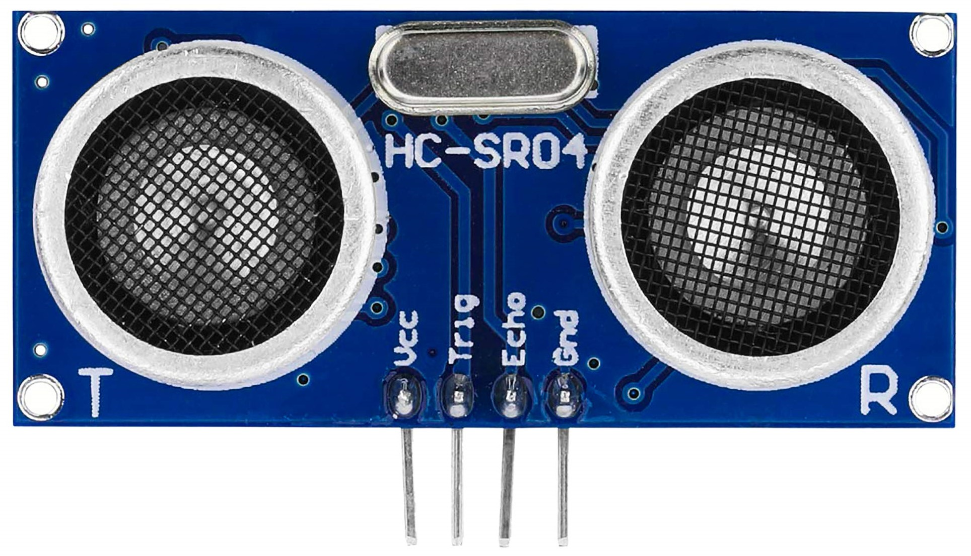

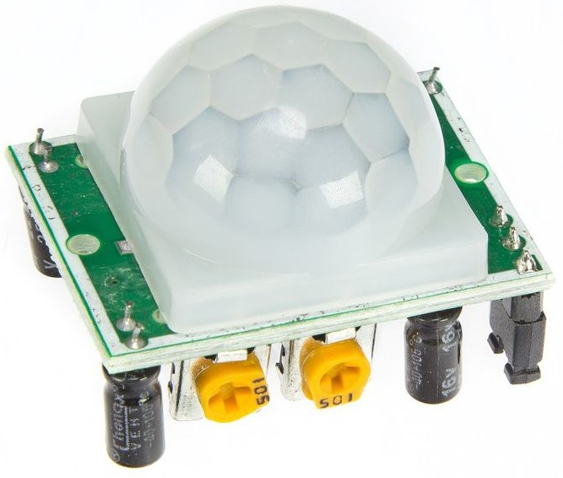
COMPONENTS
Ultrasonic Distance Sensor (HC-SR04)
Active Buzzer
PIR Motion Sensor (HC-SR501)

Slide 7
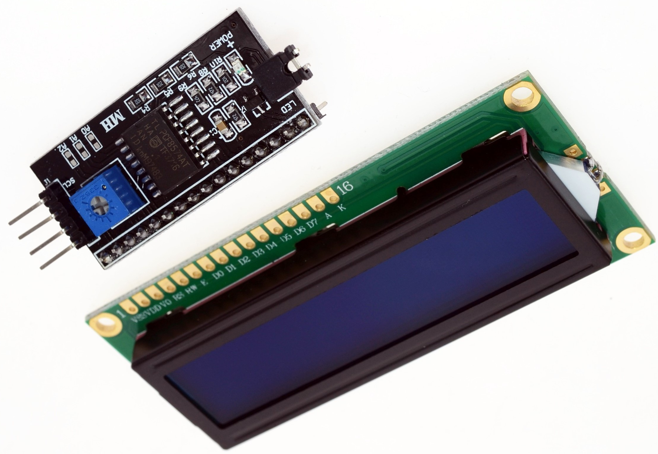
COMPONENTS
16x2 LCD I2C Display

Slide 8
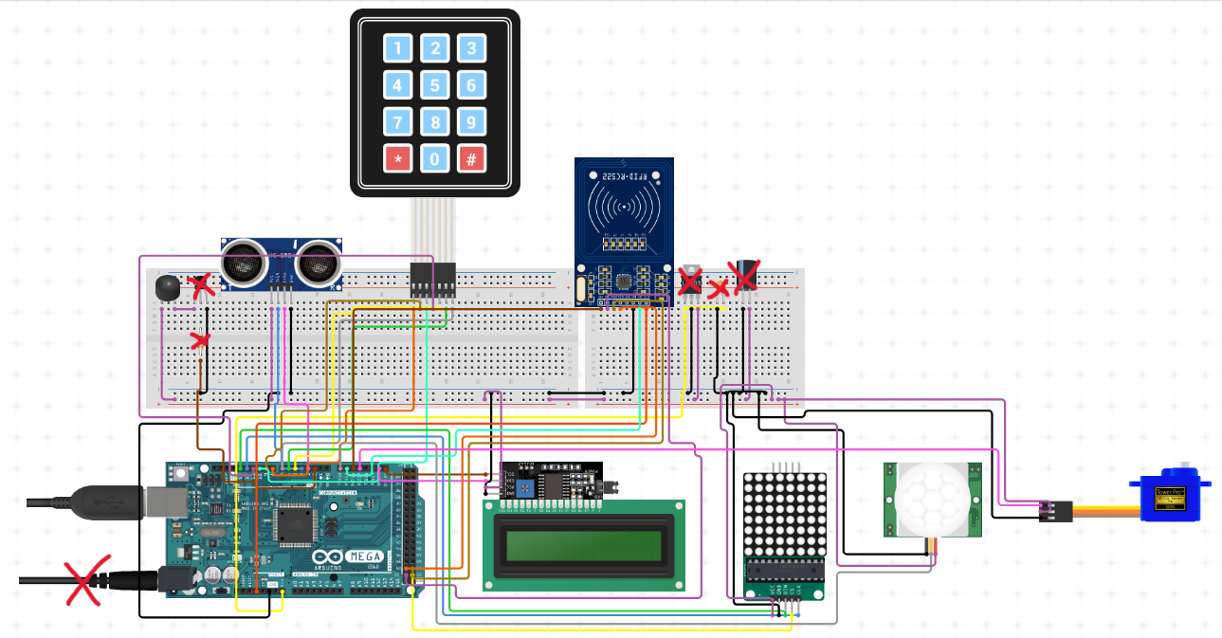
(SIMILAR) CIRCUIT DIAGRAM

Slide 9
HOW DOES IT WORK?
Once connected to a power supply, the circuit starts in an idle state. If the motion sensor detects the presence of a person within 3 meters of the system, then the DOT matrix lights up with an animation and the LCD screen also has its backlight activated and displays a generic greeting message to the person that approached the system.
When the person gets even closer to the system (<50 cm), then a second message is displayed on the LCD screen, informing the user that they need to enter an access code on the keypad. At this moment, the user has three attempts at entering the correct access code before the alarm is triggered. A code starts with a ‘*’ and ends with a ‘#’, and in between, there are four digits and/or letters from ‘A’ to ‘D’. It is important to note that the user is penalized only if they enter a wrong four-character code, meaning that if they try to enter a three-character or two-character code, then the system will not react in any way. In addition, if the user enters more than four characters, then the fifth character will actually become the new first character and so on. The star as well as the characters appear, in real time, on the LCD screen, so that the user knows at all times what the current entered code is.

Slide 10
HOW DOES IT WORK?
If the user enters a wrong access code, then a short animation will be displayed on the DOT matrix, and, at the same time, the LCD screen will inform the user of their mistake and invite them to try again. After three unsuccessful attempts, the alarm is activated and another message is displayed on the LCD screen informing the user that the alarm is on and that they need to enter a reset code in order to deactivate it. For entering this code, the way the system works is the same as explained before. If the user enters the correct reset code, then the buzzer stops making sounds and the user can, once again, try to enter the correct access code.
If the user enters a correct access code, then the system will display their name on the LCD screen alongside a message that prompts them to validate their key fob. If a wrong key fob is approached nothing happens, but if the right key fob is approached, then the system will display for the user, a final welcoming message on the LCD screen and, of course, will send a command to the servo motor that will subsequently, unlock the door.

Slide 11
THANK YOU FOR YOUR ATTENTION!
THE SOURCE CODE IS IN A SEPARATE TEXT FILE

